Slide 1
Project progress - 13/07/2020
Now working with larger dataset (4000+ samples), provides good mix of accents, male and female voices, as well as referencing both English and German speech.
RAVDESS (Ryerson AV Database of Emotional Speech and Song)
SAVEE (Surrey AV Expressed Emotion DB)
Emo-DB (Berlin Database of Emotional Speech)
TESS (Toronto Emotional Speech Set)
Should be sufficient amount of data in regards to aims concerning training the classifier - becoming more difficult to efficiently work in colab with time taken to call load_data(), starting to work locally.

Slide 2
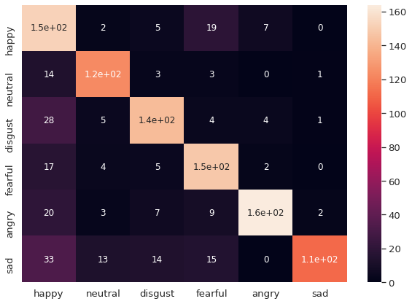
Project progress (cont.)
There is a fairly good overlap in labelling between the datasets, however some data not being utilised.
# allow only these emotions from dataset(s)
AVAILABLE_EMOTIONS = {
"neutral",
#"calm", only included in RAVDESS
"happy",
"sad",
"angry",
"fearful",
"disgust",
#"surprised" not included in emodb
}

Slide 3
Project progress (cont.)
Spending majority of time on practical aspects and improving my own knowledge of ML this past week
Areas to focus on this week:
Initial introduction draft to be improved, flow and formality.
Create custom test-set with SNR alterations, possibly various mic-profiles if available, provides better context for project
Set-up and use reference manager (large quantity of papers already earmarked)
Establish all points required in background (currently noted in overleaf)
Spend some time to further understand practical implementation which will allow textual analysis, long way to go in my understanding to describe the work being done by the network.

Slide 4
Questions for this week
Discuss dataset optimisation (ways to utilise all data, using a second measure to generalise emotions more for solution context).
Fearful for example is not something that might be useful to classify in itself in the initial concept, but might provide useful context for classification of other emotions, especially in a system where we might evaluate situations in which speakers are affected by one another.
Potential gains using DL instead of ML regarding feature extraction, how useful for audio vs. using most commonly used features from librosa.
What kinds of plot are the most useful, I should spend time on? Plotting dataset?
Examples of projects with similar data

